Slide 1
Assassination to Outbreak of War
Tour ideas and narrative

Slide 2
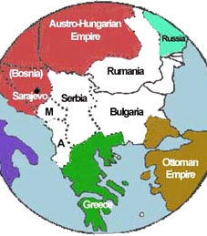
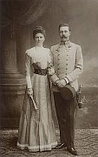
June 28, 1914
http://www.radio.cz/en/section/mailbox/mailbox-2008-03-02
http://users.humboldt.edu/ogayle/hist111/BalanceofPower.html
Notes:
Sunday, June 28th, 1914, was a bright and sunny day in Sarajevo. Sarajevo was located in the disputed territory of Bosnia. Both the Austro-Hungarian Empire and Serbia wanted this territory.
The future king of Austria, Archduke Franz Ferdinand and his wife, Sophie, visited Sarajevo. This visit in part would demonstrate that the Archduke and his family had control over the area. When it was learned that Ferdinand would visit Sarajevo, members of a Plan-Slavic group known as Unification or Death or the Black Hand –who wanted to unite ethnic Serbian territories and free them from Austo-Hungarian Influence- decided to assassinate him. If Ferdinand were assassinated, Bosnia might be able to join Serbia and form a new state. On June 28th, six teenage assassins waited among the crowds that lined the streets to watch the royal procession. The Archduke and his wife rode in an open topped vehicle. The first two assassins lost their nerve and let the car pass. Why would they lose there nerve?

Slide 3
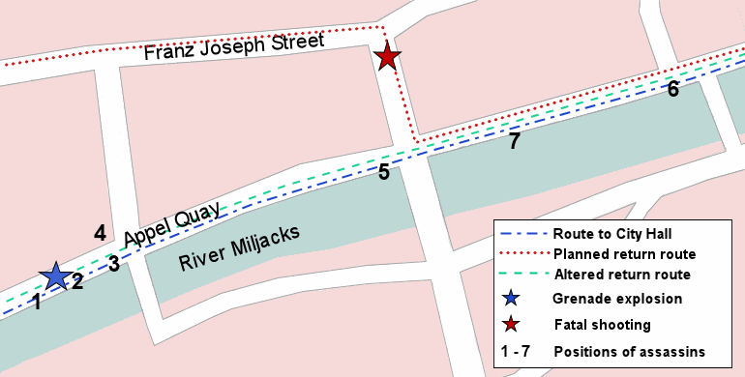
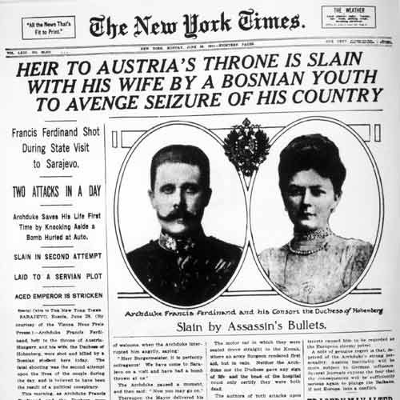
http://www.assassinationinfo.com/Assassinations/Franz_Ferdinand/events.htm
http://news.ca.msn.com/9-11-anniversary/worst-terrorist-attacks-in-history?page=8
Notes:
The third assassin threw a bomb at the car, but the Archduke saw it coming and threw it off his vehicle. It exploded under the car behind him, injuring several people. The Archduke’s driver sped away, fearing more bombs. The other assassins assumed the explosion meant the Archduke had been killed. They left the scene, with the exception of Gavrilo Princip, who soon learned the truth. Upset that the assassination plot had failed, Princip wandered across the street towards a café. He was standing outside the café when the Archduke’s driver made a wrong turn. Princip found himself only a few feet from the car. He pulled a pistol from his coat pocket and fired two shots at close range. He hit Ferdinand with one bullet, and the other ricocheted off the car and hit Sophie. Both died approximately fifteen minutes later. If Princip had not been at the café, what do you think would have happened that day? Why? Do you think War would have broken out anyway at some point?

Slide 4
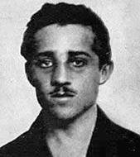
“I am not a criminal, because I destroyed that which was evil. I think that I am good.”
Gavrilo Princip
October 12, 1914
http://en.wikipedia.org/wiki/Gavrilo_Princip
http://www.ucis.pitt.edu/eehistory/H200Readings/Topic6-R3.html
Notes:
Main Bud 2 “I am not a criminal because I destroyed that which was evil. I think that I am good.” These were the words spoken by Gavrilo Princip at his trial in October of 1914, almost four months after he assassinated Austrian Archduke Franz Ferdinand and his wife, Sophie, during a visit to Sarajevo. By the time Princip faced trial, Europe had been at war for two months. Do you think that what happened that day was really enough to cause World War I? Two years later Princip admitted that if he had known that the events following the assassination would have led to War- he would never have fired his gun.

Slide 5
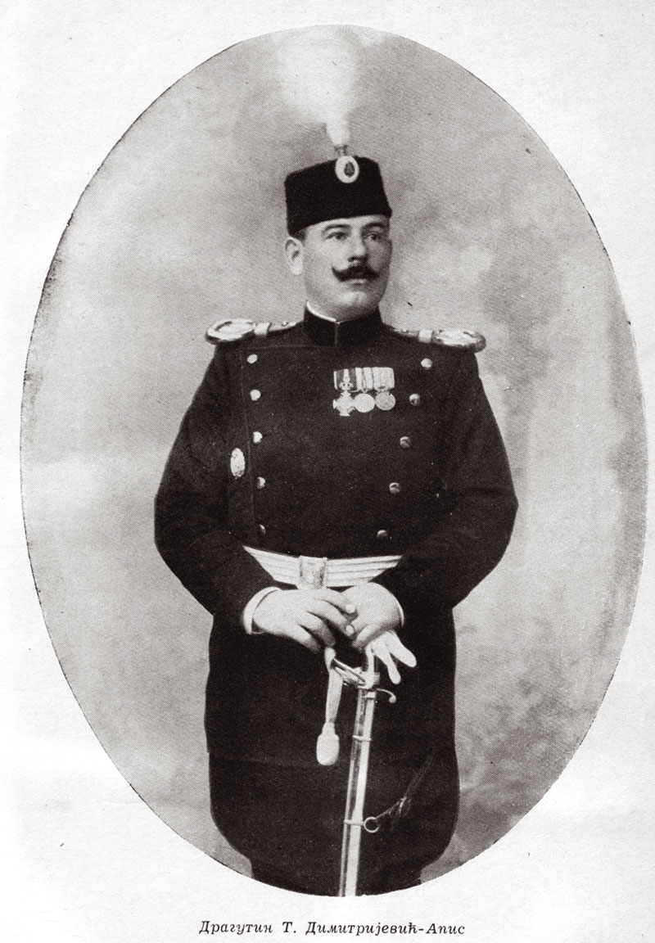
“It is clear from the statements and confessions of the criminal authors of the assassination of the twenty-eighth of June, that the murder at Sarajevo was conceived at Belgrade, that the murderers received the weapons and the bombs with which they were equipped from Serbian officers and officials who belonged to the Narodna Odbrana, and, finally, that the dispatch of the criminals and of their weapons to Bosnia was arranged and effected under the conduct of Serbian frontier authorities.”
Austro-Hungarian Ultimatum to Serbia, July 23, 1914
http://wwi.lib.byu.edu/index.php/The_Austro-Hungarian_Ultimatum_to_Serbia_(English_translation)
http://en.m.wikipedia.org/wiki/File:Dragutin_dimitrijevic_apis.jpg
Notes:
The month after the assassination saw a flurry of activity as Austria demanded justice for what they saw as state sponsored terrorism. Austrian officials believed the Serbian government was behind the attack. We now know that a Serbian Army office named Dragutin Dimitrijevic, along with two colleagues, trained the assassins and planned the attack. Tensions were already high between Austria-Hungary and Serbia over territorial disputes. The empire blamed the Serbian government not only for the assassination, but also for fostering unrest against Austria-Hungary in Bosnia. The unrest in Bosnia was a danger to the empire and after the assassination Austria-Hungary felt the only solution was an invasion of Serbia. The empire however was fearful of Russia, a close ally of Serbia and turned to it’s own ally Germany for advice. Kaiser Wilhelm felt that Russia was unprepared for war and would not intervene and urged Austria-Hungary to carry out an attack. On the chance that Russia did become involved, Wilhelm issued a “blank check” to the empire and promised it’s full support to the empire. In letter from the Austrian ambassador to Berlin to the Austro-Hungarian foreign minister on the 5th of July 1914. The ambassador explained that in a lunch meeting with Kaiser Wilhelm of Germany “when I again called attention to the seriousness of the situation, the Kaiser authorised me to inform our gracious Majesty that we might in this case, as in all others, rely upon Germany’s full support. He must first hear what the German] Imperial Chancellor [Bethmann Hollweg] has to say, but he did not doubt in the least that Herr von Bethmann Hollweg would agree with him. Especially as far as our action against Serbia was concerned. But it was his [Kaiser Wilhelm’s] opinion that this action must not be delayed. Russia’s attitude will no doubt be hostile, but to this he had been for years prepared, and should a war between Austria-Hungary be unavoidable, we might be convinced that Germany, our faithful ally, would stand by our side. Russia at the present time was in no way prepared for war, and would think twice before it appealed to arms. But it will certainly set other powers on the Triple Alliance and add fuel to the fire in the Balkans. He understands perfectly well that His Apostolic Majesty [the emperor of Austria-Hungary] in his well-known love of peace would be reluctant to march into Serbia; but if we had really recognised the necessity of warlike action against Serbia, he [Kaiser Wilhelm] would regret if we did not make use of the present moment, which is all in our favour. “ What does it mean to be given a blank check?
On July 23rd, 1914, Austria sent Serbia an ultimatum. The ultimatum in part demanded that Serbia allow Austrian officials to investigate the assassination on Serbian soil. The document also blamed the Serbian government for allowing anti-Austro-Hungarian propaganda to be published, and for being tolerant of groups that were a threat to the empire. Serbia was given 48 hours to respond to the ultimatum or the empire would declare war. The short response time would prevent other European powers from pushing for a peaceful solution and allow Austria-Hungary to invade and try to dispel the unrest and gain additional territory to expand it’s empire.

Slide 6
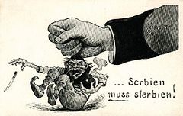
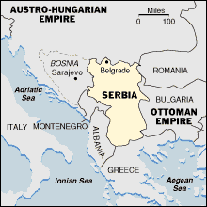
Austria-Hungary propaganda cartoon after the assassination of Archduke Ferdinand. The text reads “Serbia must die.”
http://en.wikipedia.org/wiki/Serbian_Campaign_(World_War_I)
http://www.pixelpress.org/bosnia/context/yugo1815.GIF.html
Notes:
On July 25, 1914, Serbia responded to the ultimatum. It did not accept all the provisions and three days later, on July 28th, Austria-Hungary declared war on Serbia and began to attack the capital, Belgrade. The declaration of war and subsequent attack affected many other countries in Europe due to the alliance system. Germany had agreed to support the Austria-Hungarian empire in the event of war. Russia, as an ally of Serbia, began to mobilize to help defend Serbia the day after the attacks on Belgrade began. At the same time in a telegram from Russian Tsar Nicholas II to Kaiser Wilhelm of Germany the Tzar appealed to the Kaiser to do everything he could to prevent the spread of War. “In this serious moment I appeal to you to help me. An ignoble war has been declared on a weak country [Serbia]. The indignation in Russia, fully shared by me, is enormous, I foresee that very soon I shall be overwhelmed by the pressure brought upon me, and be forced to take measures which will lead to war. To try and avoid such a calamity as a European war, I beg you in the name of our old friendship to do what you can to stop your allies going too far.”
However as Germany learned of Russia’s mobilization, they threatened war unless Russia backed off. Russia refused, and on August 1st Germany declared war on Russia. Do you think if they had accepted the ultimatum War would have broken out? Why do you think the Serbs refused to allow Austrian officials to come to Serbia to investigate the assassination?

Slide 7
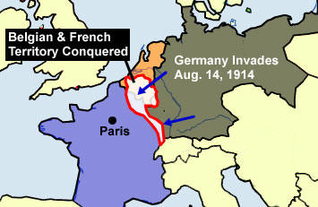
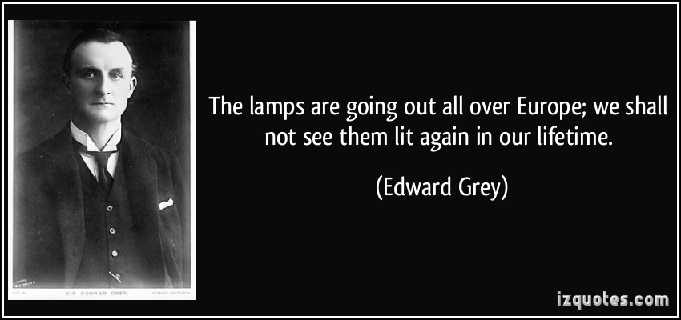
http://www.worldology.com/Europe/world_war_1.htm
http://izquotes.com/quote/75753
Notes:
German troops also moved towards Luxembourg and neutral Belgium. France, an ally of Russia, began to mobilize it’s troops on August 2nd in case of attack. On August 3rd, Germany declared war on France and invaded Belgium. That same day, Great Britain ordered Germany to withdraw from Belgium. When the Germans did not comply, Britain declared war on Germany on August 4th.

Slide 8
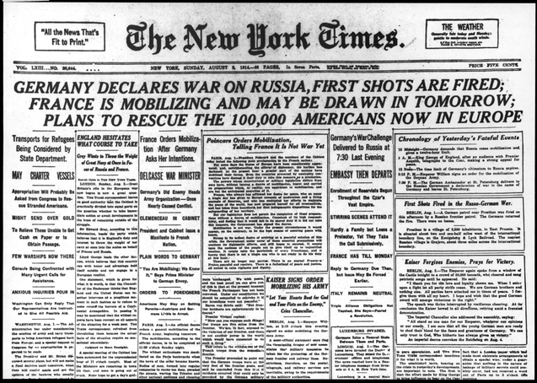
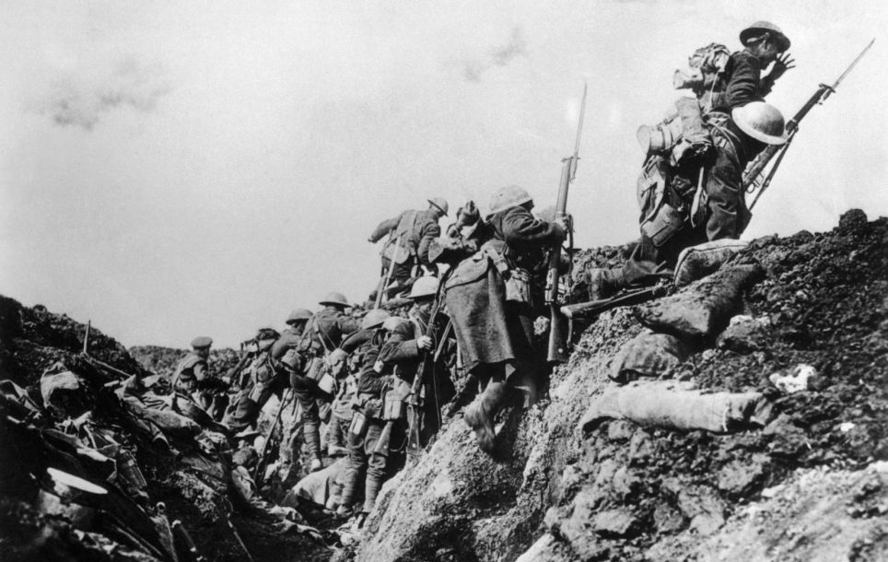
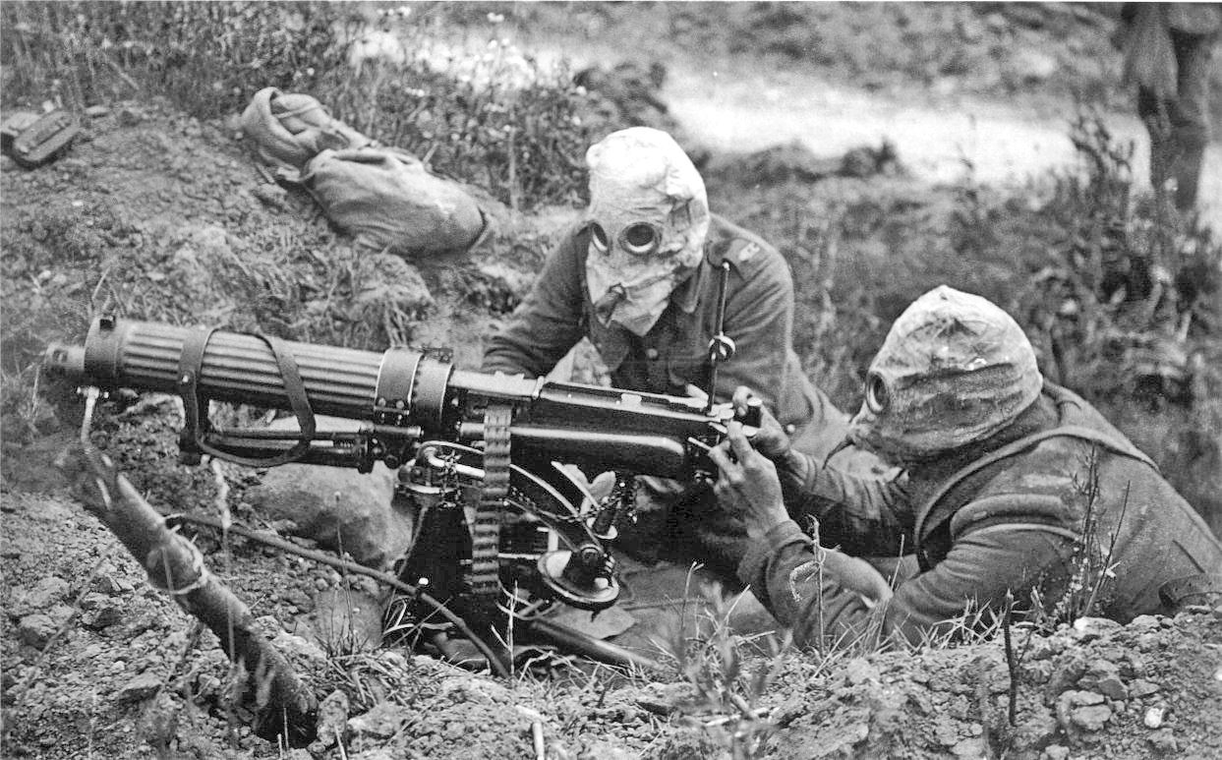
http://collections.yadvashem.org/photosarchive/en-us/5749732_6839.html
http://www.dailymail.co.uk/news/article-2226235/Historian-Andrew-Robertshaw-builds-60ft-long-First-World-War-TRENCH-Surrey-garden-highlight-plight-frontline-Tommies.html
http://en.wikipedia.org/wiki/Chemical_weapons_in_World_War_I
Notes:
Since 1914, many people generally consider the assassination of Franz Ferdinand by Gavrilo Princip to be the catalyst that set off World War I. Were there other causes of World War I? What were the short and long term causes? Why have people associated the death of Ferdinand with the start of the war? Did his death actually cause anything?

Slide 9
But how could the murders in Sarajevo lead so quickly to all-out war with so many European Powers involved?

Slide 10
Did Ferdinand’s death really cause anything? Did it really start the Great War?

Slide 11
What other factors can be found- both long and short term- that help us more fully understand the cause of the Great War?

Slide 12
Can one man Gavrillo Princip really be the cause of the Great War?
Who should really bear the blame for the Great War? And Why?

